Slide 1


Department of Computer Science and Engineering BITCOIN HEIST RANSOMWARE ATTACK PREDICTION using Data Science Process
BATCH: A3
Harshavarthini R : 211419104097
Isabella Mary J : 211419104106
Muthupriya M : 211419104172
GUIDE: Dr.T.Jackulin,M.E.,Ph.D.,
Associate Professor
CO-ORDINATOR: Dr.Kavitha Subramani,M.E.,Ph.D.,
Supervisor

Slide 2
INTRODUCTION
Ransomware attacks are emerging as a major source of malware intrusion in recent times. While so far ransomware has affected general-purpose adequately resourceful computing systems.
Many ransomware prediction techniques are proposed but there is a need for more suitable ransomware prediction techniques for machine learning techniques.
This paper presents an attack of ransomware prediction technique that uses for extracting information features in artificial intelligence and machine learning algorithms for predicting ransomware attacks.
The application of the data science process is applied for getting a better model for predicting the outcome. Variable identification and data understanding is the main process of building a successful model.
Different machine learning algorithms are applied to the pre-processed data and the accuracy is compared to see which algorithm performed better other performance metrics like precision, recall, f1-score are also taken in consideration for evaluating the model.
The machine learning model is used for predicting the ransomware attack outcome.

Slide 3
Objectives
The objective of the work is to help towards building a better understanding of the ransomware threat landscape.
It introduces a practical approach for building effective tools for detection and mitigation of ransomware attacks by monitoring their pre-attack activities and attributing them to known families during early phases.
The goal is to develop a machine learning model for Crypto Ransomware Attack Prediction.
To potentially replace the updatable supervised machine learning classification models by predicting results in the form of best accuracy by comparing supervised algorithm.

Slide 4
Scope
The machine learning model is designed to work on the bitcoin heist data set to classify the different malicious transactions.
The different transactions features are analyzed to predict a classifier label among the classifiers that have been identified as ransomware or associated with malicious activity.
The main scope is to detect the Crypto Ransomware attack Prediction, which is a classic text classification problem with a help of machine learning algorithm.
It is needed to build a model that can differentiate Crypto Ransomware attacks.
The results are assessed to evaluate accuracy, precision, and recall for the algorithms implemented on each module.

Slide 5
LITERATURE SURVEY
S.NO | YEAR | AUTHOR(S) | PAPER DETAILS | MERITS/ DEMERITS | FUTURE SCOPE
1. | 2022 | Ricardo Misael Ayala Molina, Sadegh Torabi, Khaled Sarieddine, Elias Bou-Harb, Nizar Bouguila, Chadi Assi | On Ransomware Family Attribution Using Pre-Attack Paranoia Activities Volume: 19 Issued on: 03, 2022 Journal: IEEE (Institute of Electrical and Electronics Engineers) Methodology: Bernoulli Naive Bayes (BNB), k-Nearest Neighbour (k-NN), Random Forest(RF) Accuracy: 94.92% | Merits: The RF model obtained the best classification outcomes (i.e., accuracy and F-measure). Demerits: The ANN model produced the smallest computational times for completing the ransomware classification process. | This introduces a practical approach for building effective tools for detection and mitigation of ransomware attacks by monitoring their pre-attack activities and attributing them to known families during early phases.

Slide 6
S.NO | YEAR | AUTHOR(S) | PAPER DETAILS | MERITS/ DEMERITS | FUTURE SCOPE
2. | 2022 | Suleiman Ali Alsaif | Machine Learning-Based Ransomware Classification of Bitcoin Transactions Volume: 2022 Issued on: 12, 2022 Journal: Applied Computational Intelligence and Soft Computing Methodology: XGBoost, Logistic Regression, Random Forest Classifier Accuracy: 88% | Merits: The resulting model accuracy is higher than many recent state-of-the-art models developed to detect ransomware payments in bitcoin. Demerits: It may be difficult to detect zero-day ransomware attacks with statistical methods. | Considering planning threat intelligence information to increase the accuracy of our prediction model and analyze the impact of hyperparameter tuning on the result of the predictive model using several MLA’s.

Slide 7
S.NO | YEAR | AUTHOR(S) | PAPER DETAILS | MERITS/ DEMERITS | FUTURE SCOPE
3. | 2022 | J. Hernandez-Castro, A. Cartwright and E. Cartwright | An economic analysis of ransomware and its welfare consequences Volume: 07 Issued on: 01, 2020 Journal: Royal Society Open Science Methodology: Uniform pricing, Price Discrimination Accuracy: 85% | Merits: This may create a remit for policymakers to highlight more strongly the social responsibilities around cyber-behaviour. | Predicting how ransomware may evolve in the future.

Slide 8
S.NO | YEAR | AUTHOR(S) | PAPER DETAILS | MERITS/ DEMERITS | FUTURE SCOPE
4. | 2022 | Hardi Sabah Talabani, Hezha M.TAREQ Abdulhadi | Bitcoin Ransomware Detection Employing Rule-Based Algorithms Volume: 10 Issued on: 01, 2022 Journal: Science Journal of University of Zakho Methodology: Decision Table, Partial Decision Tree (PART) Accuracy: 89.01% | Merits: Classifiers can efficiently identify the ransomware in a bitcoin dataset with experimental studies and therefore obtained superior predictive performance. | Employing a hybrid approach in detecting ransomware attacks and extending the analysis for more and various versions of ransomware attacks and real time practice.

Slide 9
S.NO | YEAR | AUTHOR(S) | PAPER DETAILS | MERITS/ DEMERITS | FUTURE SCOPE
5. | 2022 | Abdullah Alqahtani, Frederick T. Sheldon | A Survey of Crypto Ransomware Attack Detection Methodologies: An Evolving Outlook Volume: 22 Issued on: 05, 2022 Journal: MDPI (Multidisciplinary Digital Publishing Institute) Open Access Journals Methodology: Data centric based and Process centric based approaches, Event based detection Accuracy: 90% | Merits: The focus is on crypto ransomware as the most prevalent, destructive, and challenging variation. Demerits: The major issue with early detection is the lack of enough data and behavioral patterns at the beginning of the attack. | Investigating the correlation between the API and other events related to the malicious process.

Slide 10
S.NO | YEAR | AUTHOR(S) | PAPER DETAILS | MERITS/ DEMERITS | FUTURE SCOPE
6. | 2021 | Sabira Karim, Shemitha PA | A Survey on Detection and Classification of Ransomware Bitcoin Transactions Volume: 07 Issued on: 03, 2021 Journal: IJARIIE-ISSN(O)-2395-4396 ( International Journal of Advance Research and Innovative Ideas in Education) Methodology: Random Forest Algorithm, k-Nearest Neighbour (k-NN) Algorithm Accuracy: 90.32% | Merits: This paper investigates the many effects of various supervised machine learning approaches for effective identification of bitcoin payments for ransomware perpetuators. Demerits: The findings of the algorithms want any exploration on the datasets having extreme category imbalances also. | Future work may be done to validate the results on more modern spurious bitcoin transactions involving crime like ransomware payments and cash launder.

Slide 11
S.NO | YEAR | AUTHOR(S) | PAPER DETAILS | MERITS/ DEMERITS | FUTURE SCOPE
7. | 2021 | Vytarani Mathane, P.V. Lakshmi | Predictive Analysis of Ransomware Attacks using Context-aware AI in IoT Systems Volume: 12 Issued on: 04, 2021 Journal: International Journal of Advanced Computer Science and Applications(IJACSA) Methodology: Support Vector Machine Algorithm Accuracy: 60% | Merits: Deployment paths to build predictive models for determining the probability of ransomware attacks have been focused. Demerits: Subsequent events like port scanning, encryptions, lockouts of data acquisition units are out of scope. | An ontology tool will be used to get context-aware data to develop attack filters.

Slide 12
S.NO | YEAR | AUTHOR(S) | PAPER DETAILS | MERITS/ DEMERITS | FUTURE SCOPE
8. | 2021 | Micheline Al Harrack | The BitcoinHeist: Classifications of Ransomware Crime Families Volume: 13 Issued on: 10, 2021 Journal: IJCSIT (International Journal of Computer Science and Information Technology) Methodology: Random Forest Classifier, Decision tree Classifier Accuracy: 89% | Merits: Simple in design and powerful in predicting ransomware families in supervised context. | Clustering the Bitcoin Heist transactions to identify any possible commonalities among families of ransomwares.

Slide 13
S.NO | YEAR | AUTHOR(S) | PAPER DETAILS | MERITS/ DEMERITS | FUTURE SCOPE
9. | 2020 | Kirat Jadhav | Investigating Machine Learning Approaches for Bitcoin Ransomware Payment Detection System Volume: 05 Issued on: 09, 2020 Journal: International Journal of Innovative Science and Research Technology Methodology: Multilayer Perceptron approaches, Naïve Bayes, k-Nearest Neighbour (k-NN) Algorithm Accuracy: 84% | Merits: The class imbalance did not have as much effect. | Validate the results on more recent spurious bitcoin transactions involving cybercrime such as ransomware payments and money launder.

Slide 14
S.NO | YEAR | AUTHOR(S) | PAPER DETAILS | MERITS/ DEMERITS | FUTURE SCOPE
10. | 2018 | Jason E. Thomas | Individual Cyber Security: Empowering Employees to Resist Spear Phishing to Prevent Identity Theft and Ransomware Attacks Volume: 13 Issued on: 06, 2018 Journal: International Journal of Business and Management Methodology: Protection Motivation Theory (PMT), Theory and Planned Behavior (TPB) Accuracy: 84.05% | Merits: A succinct and clear interview guide was designed for and used in the study to guide the interview process. | The Bitcoin Heist data set to classify the different malicious transactions.

Slide 15
S.NO | YEAR | AUTHOR(S) | PAPER DETAILS | MERITS/ DEMERITS | FUTURE SCOPE
11. | 2018 | Navneet Kaur Popli, Anup Girdhar | Behavioural Analysis of Recent Ransomwares and Prediction of Future Attacks by Polymorphic and Metamorphic Ransomware Volume: 799 Issued on: 09, 2018 Journal: Computational Intelligence: Theories, Applications and Future Direction Methodology: Intrusion Detection System (IDS), Shellcodes Accuracy: 80% | Merits: An analytical study of the behaviours of the recent ransomwares that have attacked businesses and individuals alike. | Run them in a simulation environment and analyse their attack process, file system analysis.

Slide 16
PROBLEM STATEMENT
The systems proposed until now implies that the previous approaches have not employed advanced Data Analytics techniques to automatically detect ransomware related transactions and malicious bitcoin addresses.
By applying different models to each domain, accuracy is found. By doing this, we can predict which model will give a higher accuracy rate.
The systems also did not attempt to predict the ransomware attacks into the class of the families.
So, our project is to build a model which will be able to predict those types of ransomware attacks.
This will prevent them from restricting access to infected computers by encrypting its contents and take actions for primary defenses.

Slide 17
Existing System
Ransomware attacks are among the most disruptive cyber threats, causing significant financial losses while impacting productivity, accessibility, and reputation.
Despite their end goals (encryption/locking), ransomware are often designed to evade detection by executing a series of pre-attack API calls, namely “paranoia” activities, for determining a suitable execution environment.
In this work, a first-of-a-kind effort to utilize such paranoia activities for characterizing ransomware distinguishable behaviours. To this end, draw-upon more than 3K samples from recent/prominent ransomware families to fingerprint their uniquely leveraged paranoia activities.
In this work, a dynamic analysis approach for attributing ransomware samples based on their pre-attack paranoia activities.
The execution of more than 3,000 ransomware samples that belong to 5 predominant families in a sandboxing environment to collect their behavioural characteristics/features in terms of 23 selected pre-attack evasion API calls that are associated with sensing the execution environment.

Slide 18
Drawbacks
The ransomware attacks predicted in the existing system were not mentioned with their kind which denotes their behavioural patterns.
The algorithms implemented other than random forest classfier could not give much accuracy as there wasn’t enough dataset.
The ransomware attacks recognised had class imbalances which couldn’t predict the patterns as much needed.

Slide 19
Proposed System
The proposed system is to build a model able to predict the types of ransomware attacks. The process starts with variable identification like dependent and independent variables where we find the target column.
Then the pre-processing techniques are applied to deal with missing values the pre-processed data is then used to build a model by dividing the dataset into 7:3 ratios.
As 70% of the data is used for training purposes that are model learns the pattern and the remaining 30% testing data is used to test the performance of our project.
The classification model can be used to predict the bitcoin heist ransomware attack types.

Slide 20
Advantages
The proposed system is implemented particularly based on bitcoin ransomware attack prediction.
The implementation of an algorithm known as the voting classifier is done for the identification of best classification results.
The dataset involves more than 14K sample of features which could give the best accuracy for attack prediction.
The deployment of ransomware attack prediction is done with necessary inputs and designed for the end users.

Slide 21
Environmental RequirementS
Software Requirements
Operating System : Windows
Tool : Anaconda with Jupyter Notebook
Hardware requirements
Processor : Pentium IV/III
Hard disk : minimum 80 GB
RAM : minimum 2 GB

Slide 22
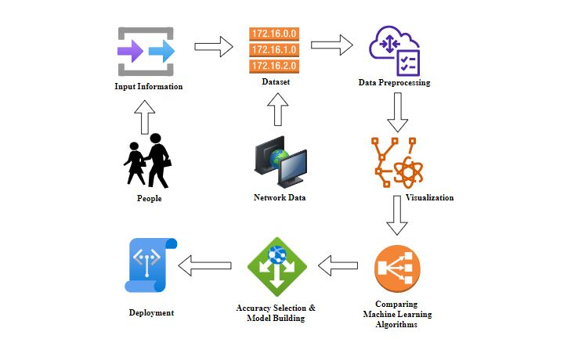
System Architecture

Slide 23
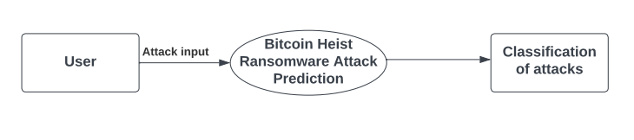
Dataflow diagram – level 0

Slide 24
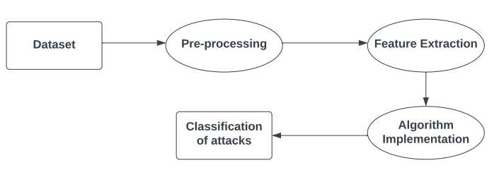
Dataflow diagram – level 1

Slide 25
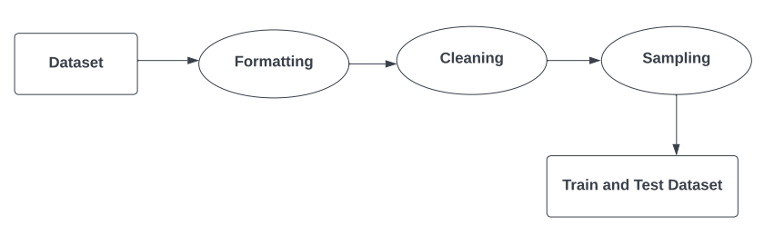
Dataflow diagram – level 2

Slide 26
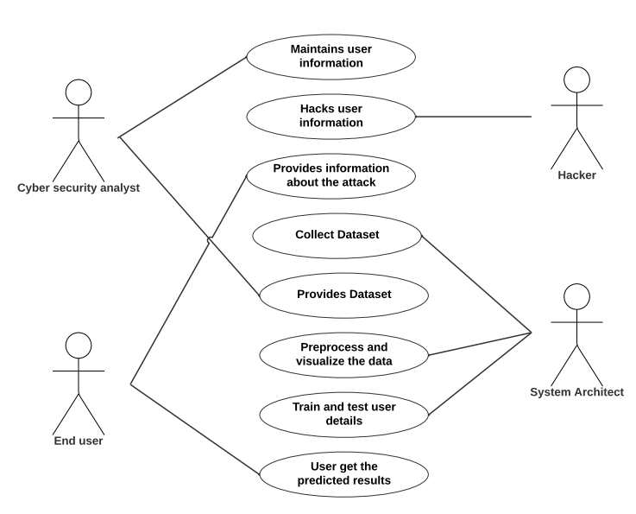
use case diagram

Slide 27
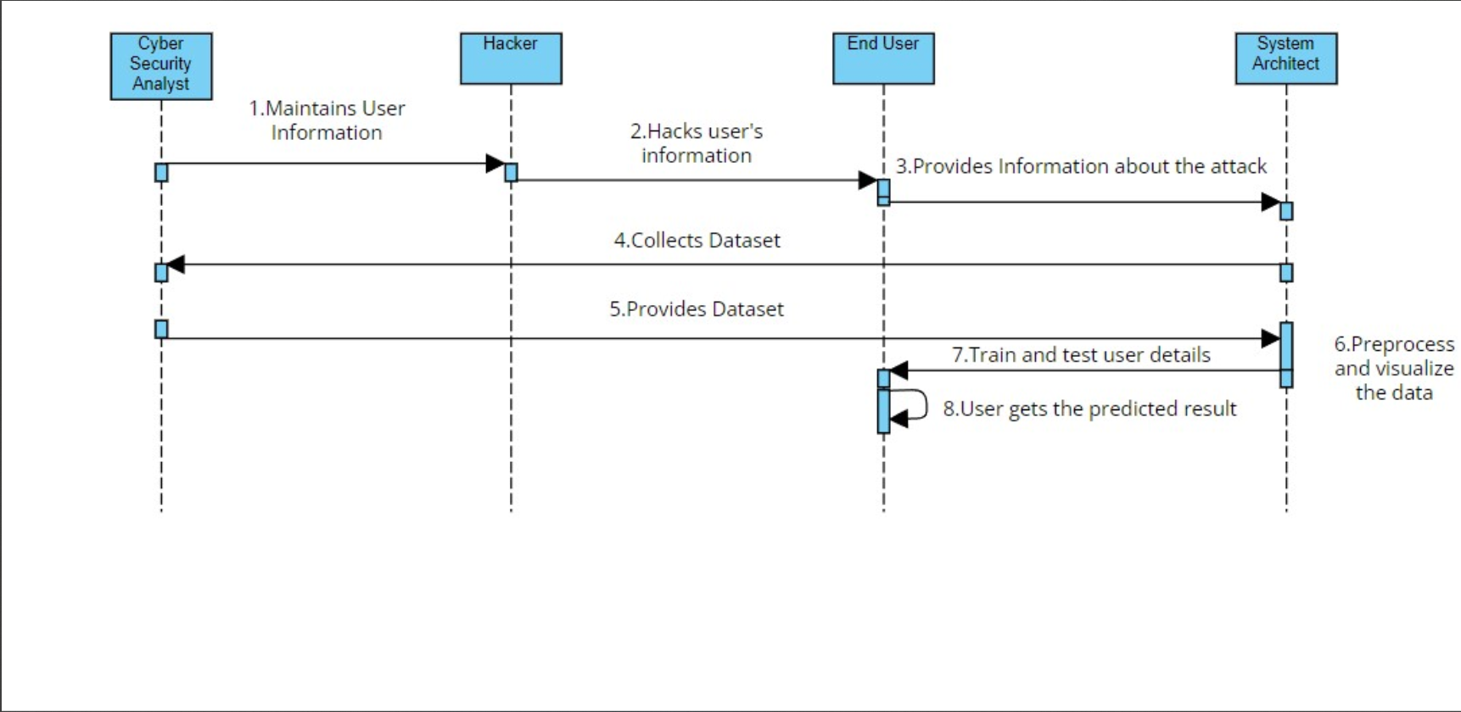
sequence Diagram

Slide 28
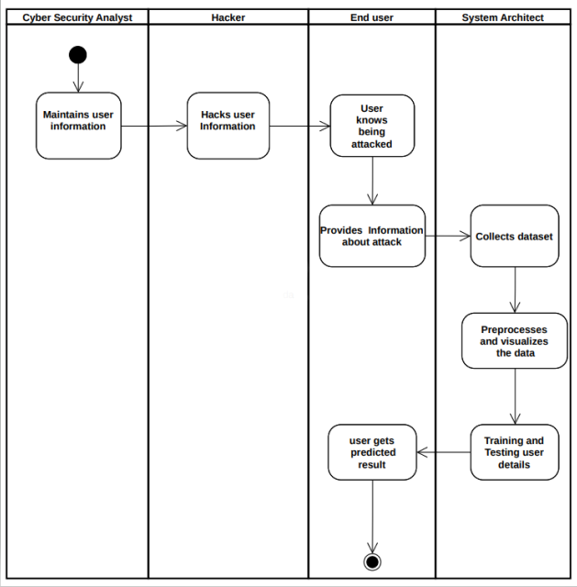
activity Diagram

Slide 29
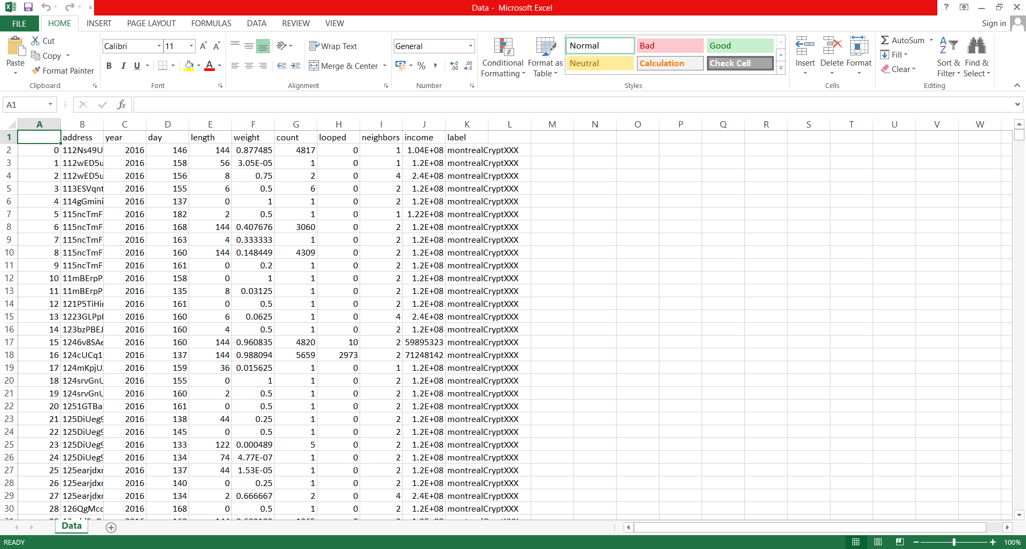
Preparing the Dataset
This dataset contains 14514 records of features, which were then classified into 6 classes.
That is:
Cerber
Crypto
Crypto Locker
Crypto Wall
Locky
White
Dataset: Types of Attacks and Input Features

Slide 30
Module DESCRIPTION
Data Pre-processing.
Data Analysis of Visualization.
Implementing XGBoost Algorithm and Finding the Accuracy.
Implementing Random Forest Classifier and Finding the Accuracy.
Implementing Logistic Regression Algorithm and Finding the Accuracy.
Implementing Voting Classifier Algorithm and Finding the Accuracy.
Deployment Using Flask.

Slide 31
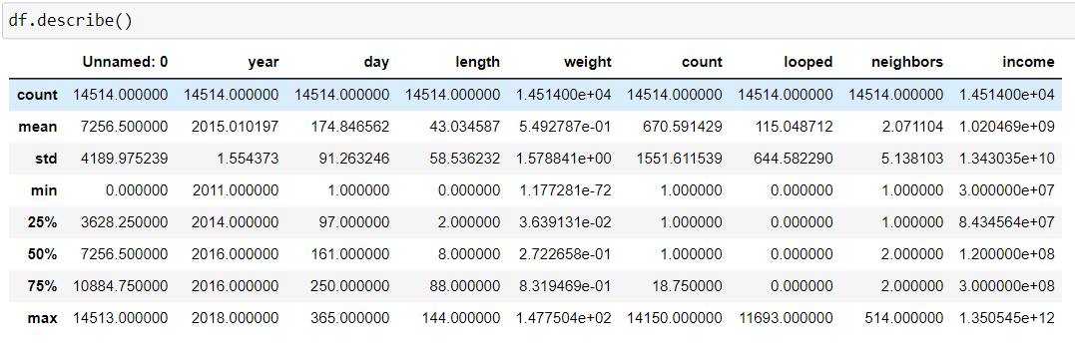
Module 1: Data pre-processing
Data pre-processing is performed to transform the raw data into a useful and efficient format by removing noise and inconsistent data.
So, it creates the reliable consistent data that improves the efficiency of the training data for analysis and also enables accurate decision – making.
1.Describing the data:

Slide 32
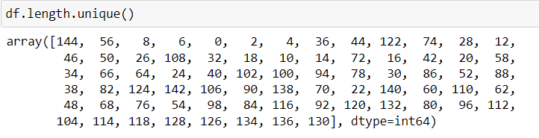
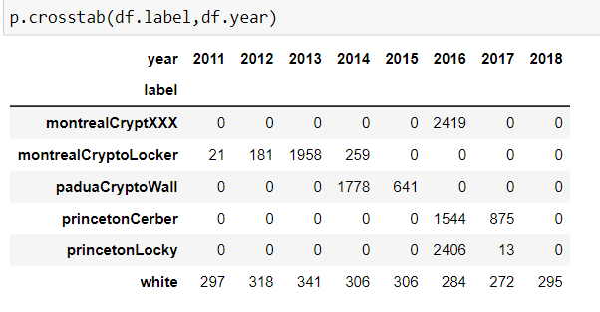
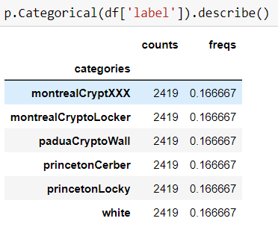
2.Checking the unique length values:
3.Identifying the label in accordance with year:
4.Identifying the label count and frequencies:

Slide 33
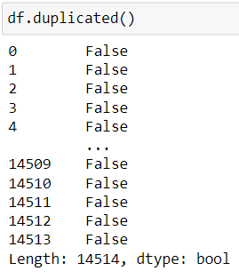
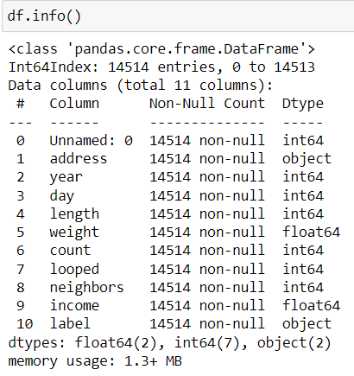
5.Identifying the duplicate data:
6.Processing the complete entries:

Slide 34
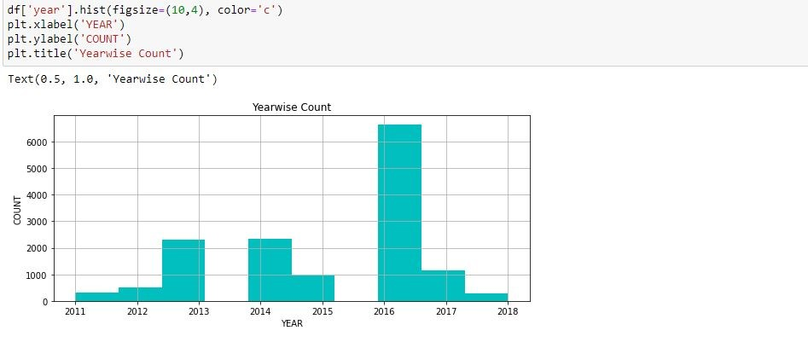
Module 2: Data visualization
Data visualization is the graphical representation of information and data in a pictorial or graphical format.
Data visualization is an important skill in applied statistics and machine learning. Statistics does indeed focus on quantitative descriptions and estimations of data.
1.Yearwise Count:

Slide 35
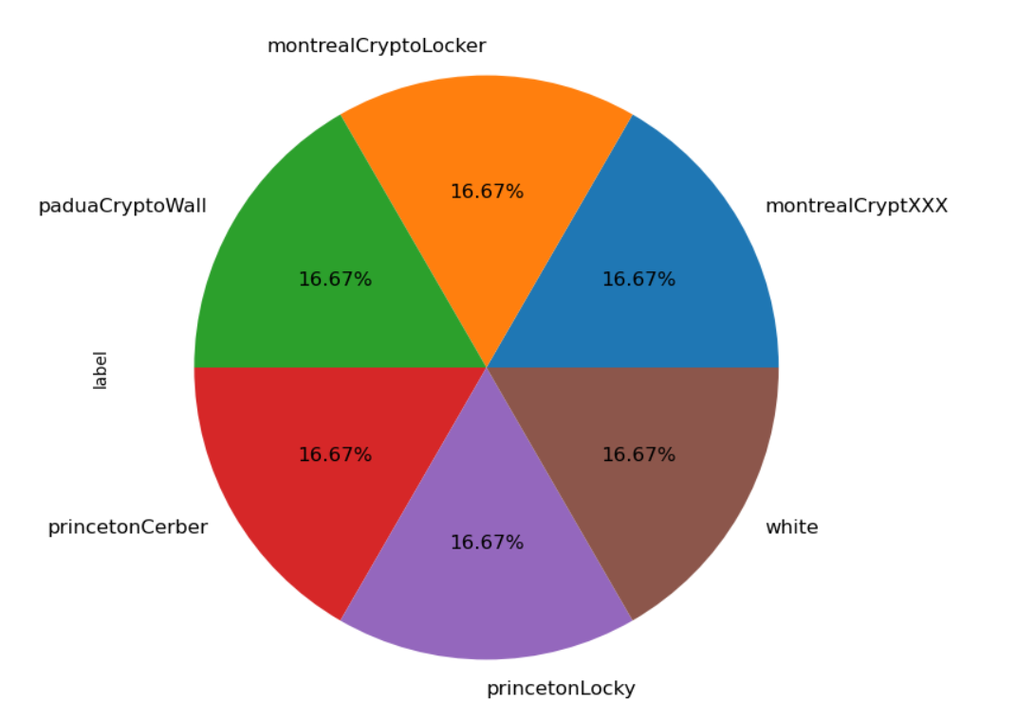
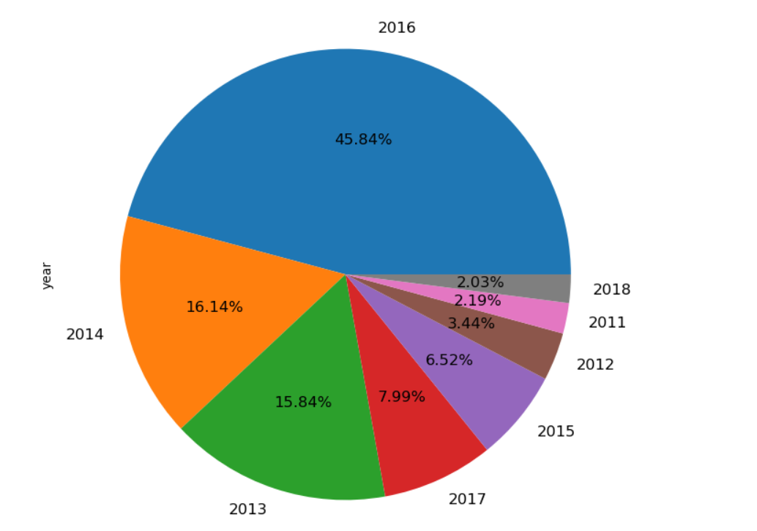
2.Piechart based on label
3.Piechart based on year

Slide 36
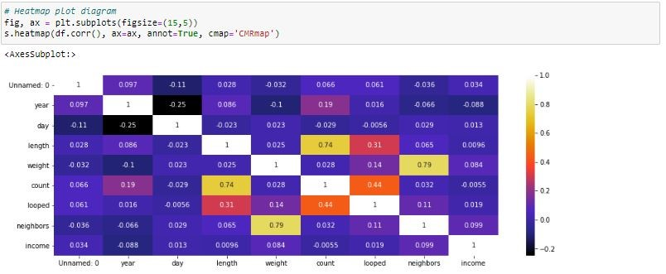
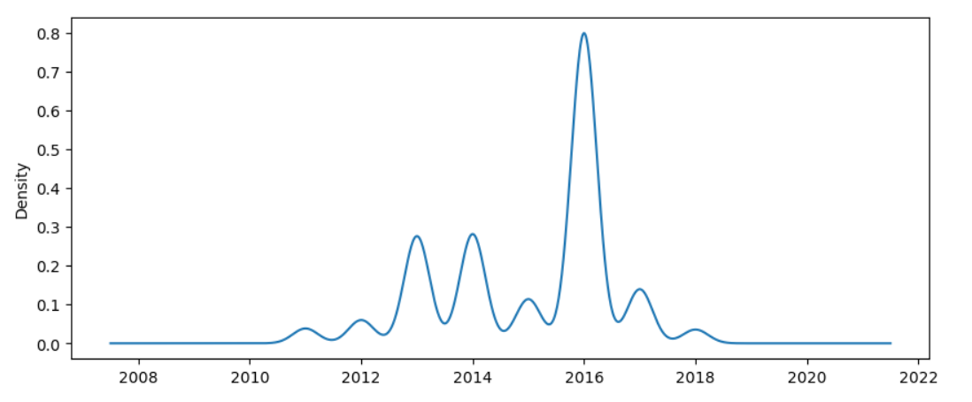
4.Heatmap plot diagram on inputs
5.Density plot for yearly attacks

Slide 37
Module 3: Logistic Regression
Logistic regression is a machine learning classification algorithm which estimates the probability of an event occurring, such as voted or didn't vote, based on a given dataset of independent variables.
The goal of logistic regression is to find the best fitting model to describe the relationship between the dichotomous characteristic of interest (dependent variable = response or outcome variable) and a set of independent (predictor or explanatory) variables.
In logistic regression, the dependent variable is a binary variable that contains data coded as 1 (yes, success, etc.) Or 0 (no, failure, etc.).

Slide 38
Module 4: Random Forest Classifier
Random forests or random decision forests are an ensemble learning method for classification, regression and other tasks, that operate by constructing a multitude of decision trees at training time and outputting the class that is the mode of the classes (classification) or mean prediction (regression) of the individual trees.
The random forest algorithm combines multiple algorithm of the same type i.e., Multiple decision trees, resulting in a forest of trees, hence the name "random forest".
The random forest algorithm can be used for both regression and classification tasks.

Slide 39
Module 5: XG BOOST Classifier
XG Boost classifier is a machine learning algorithm that is applied for structured and tabular data.
XG Boost classifier is an implementation of gradient boosted decision trees designed for speed and performance.
XG Boost is an ensemble modelling technique works with large, complicated datasets.
XG Boost is an optimized distributed gradient boosting library designed to be highly efficient, flexible and portable.

Slide 40
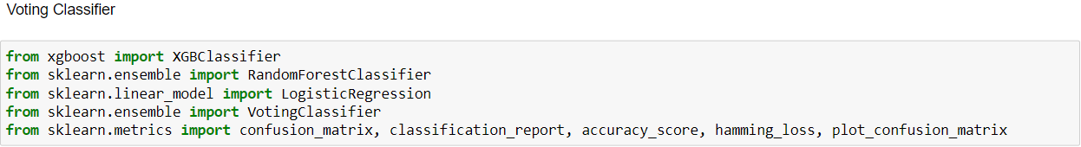
Module 6: Voting Classifier
A voting classifier is a machine learning estimator that trains various base models or estimators and predicts on the basis of aggregating the findings of each base estimator.
The idea is instead of creating separate dedicated models and finding the accuracy for each them, we create a single model which trains by these models and predicts output based on their combined majority of voting for each output class.
In hard voting, the predicted output class is a class with the highest majority of votes i.e., The class which had the highest probability of being predicted by each of the classifiers. Suppose three classifiers predicted the output class(a, A, B), so here the majority predicted A as output. Hence A will be the final prediction.

Slide 41
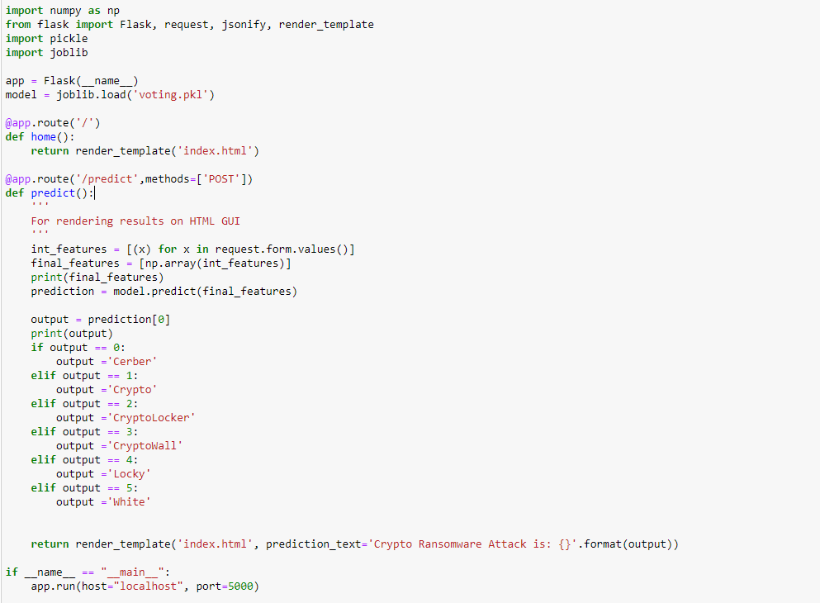
Module 7: Deployment
Flask is a micro web framework written in python.
It is classified as a micro-framework because it does not require particular tools or libraries.
It has no database abstraction layer, form validation, or any other components where pre-existing third-party libraries provide common functions.

Slide 42
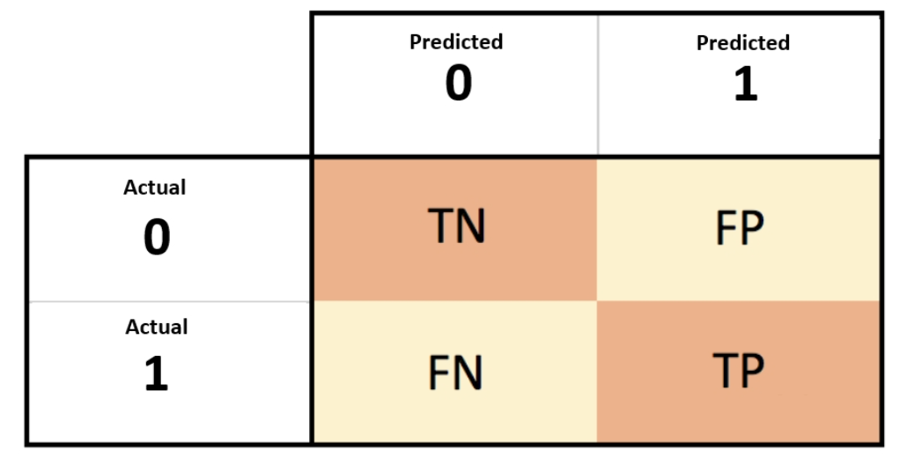
Performance EVALUATION
Confusion matrix:
True Positive Rate(TPR) = TP / (TP + FN)
False Positive rate(FPR) = FP / (FP + TN)
Accuracy = (TP + TN) / (TP + TN + FP + FN)
Precision = TP / (TP + FP)
Recall = TP / (TP + FN)
F- Measure = 2TP / (2TP + FP + FN)
F1 Score = 2*(Recall * Precision) / (Recall + Precision)

Slide 43
Performance EVALUATION
 | Precision | Recall | F1-score | Support
0 | 0.00 | 0.00 | 0.00 | 726
1 | 0.00 | 0.00 | 0.00 | 726
2 | 0.00 | 0.00 | 0.00 | 725
3 | 0.00 | 0.00 | 0.00 | 726
4 | 0.00 | 0.00 | 0.00 | 726
5 | 0.17 | 1.00 | 0.29 | 726
Accuracy |  |  | 0.17 | 4355
Macro average | 0.03 | 0.17 | 0.05 | 4355
Weighted average | 0.03 | 0.17 | 0.05 | 4355
Classification report for Logistic Regression:
Number of training dataset: 10159
Number of testing dataset: 4355
Total number of dataset: 14514

Slide 44
 | Precision | Recall | F1-score | Support
0 | 0.89 | 0.95 | 0.92 | 726
1 | 0.96 | 0.96 | 0.96 | 726
2 | 0.87 | 0.91 | 0.89 | 725
3 | 0.89 | 0.97 | 0.93 | 725
4 | 0.96 | 0.97 | 0.96 | 726
5 | 0.96 | 0.67 | 0.75 | 726
Accuracy |  |  | 0.90 | 4355
Macro average | 0.90 |  | 0.90 | 4355
Weighted average | 0.90 |  | 0.90 | 4355
Classification report for Random Forest
Classifier:
Number of training dataset: 10159
Number of testing dataset: 4355
Total number of dataset: 14514

Slide 45
 | Precision | Recall | F1-score | Support
0 | 0.90 | 0.95 | 0.93 | 726
1 | 0.97 | 0.97 | 0.97 | 726
2 | 0.86 | 0.92 | 0.89 | 725
3 | 0.91 | 0.98 | 0.94 | 726
4 | 0.97 | 0.97 | 0.97 | 726
5 | 0.85 | 0.69 | 0.76 | 726
Accuracy |  |  | 0.91 | 4355
Macro average | 0.91 | 0.91 | 0.91 | 4355
Weighted average | 0.91 | 0.91 | 0.91 | 4355
Classification report for XG Boost
Classifier:
Number of training dataset: 10159
Number of testing dataset: 4355
Total number of dataset: 14514

Slide 46
 | Precision | Recall | F1-score | Support
0 | 0.89 | 0.95 | 0.92 | 726
1 | 0.97 | 0.96 | 0.97 | 726
2 | 0.88 | 0.90 | 0.89 | 725
3 | 0.92 | 0.96 | 0.94 | 726
4 | 0.98 | 0.96 | 0.97 | 726
5 | 0.83 | 0.74 | 0.78 | 726
Accuracy |  |  | 0.91 | 4355
Macro average | 0.91 | 0.91 | 0.91 | 4355
Weighted average | 0.91 | 0.91 | 0.91 | 4355
Classification report for Voting Classifier:
Number of training dataset: 10159
Number of testing dataset: 4355
Total number of dataset: 14514

Slide 47
Model | Accuracy
Random Forest Classifier | 94.92%
Bernoulli Naive Bayes | 85.11%
k-Nearest Neighbour | 92.85%
Artificial neural network | 87.80%
Model | Accuracy
Logistic Regression | 16.67%
Random Forest Classifier | 90.53%
XG Boost Classifier | 91.34%
Voting Classifier | 91.32%
In the existing work, 3,432 samples had been drawn and the evaluations demonstrated the effectiveness of the implemented approach, with the Random Forest (RF) techniques producing an optimal classification accuracy (94.92%).
In the proposed work, 14,514 samples have been drawn and the evaluations demonstrated the effectiveness of the implemented approach, with the Extreme Gradient (XG) Boost producing an optimal classification accuracy (91.32%).

Slide 48
screenshots
Deployment using Flask (Web Framework)

Slide 49

Input Design

Slide 50


Attack Type: Montreal CryptoXXX
Attack Type: Montreal CryptoLocker

Slide 51


Attack Type: Padua CryptoWall
Attack Type: Princeton Cerber

Slide 52


Attack Type: Princeton Locky
Attack Type: White

Slide 53
Conclusion
In this work, we proposed an analysis for attributing ransomware samples based on their behavioral characteristics/features following their activities.
The analytical process started from data cleaning and processing, missing value, exploratory analysis and finally model building and evaluation.
The best accuracy on public test set is higher accuracy score will be find out. This application can help to find the Prediction of Crypto Ransomware attack.
This way can help the organisations to know more about the attacks and also will be able to identify the attacks from spam, phishing emails, malicious and hacked websites.

Slide 54
FUTUREWORK
The future works can be implemented on Crypto Ransomware attack prediction which can be connected with the cloud model.
The optimization of this work can also be better if the system and the prediction model is connected with the embedded system.

Slide 55
References
[1] Ricardo Misael Ayala Molina, Sadegh Torabi, Khaled Sarieddine, Elias Bou-harb, Nizar Bouguila, Chadi Assi. (2022) ‘On Ransomware Family Attribution Using Pre-attack Paranoia Activities’, IEEE Transactions On Network And Service Management, Vol. 19, No. 1, March 2022.
[2] Suleiman Ali Alsaif. (2022) ‘Machine Learning-based Ransomware Classification Of Bitcoin Transactions’, Applied Computational Intelligence And Soft Computing, Vol. 2022; Article ID 6274260.
[3] J. Hernandez-castro, A. Cartwright and E. Cartwright. (2022) ‘An Economic Analysis Of Ransomware And Its Welfare Consequences’, Royal Society Open Science, Vol. 07, Issue 3, March 2022; https://doi.org/10.1098/rsos.190023.
[4] Hardi Sabah, Talabani, Hezha M.TAREQ Abdulhadi. (2022) ‘Bitcoin Ransomware Detection Employing Rule Based Algorithms’, Science Journal Of University Of Zakho, Vol. 10, No. 1: January - March Issue; https://doi.org/10.25271/sjuoz.2022.10.1.865.

Slide 56
[5] Abdullah Alqahtani, Frederick T. Sheldon. (2022) ‘A Survey Of Crypto Ransomware Attack Detection Methodologies: An Evolving Outlook’, MDPI Open Access Journals, Vol. 22, Sensors, 22(5), 1837; https://doi.org/10.3390/s22051837.
[6] Sabira Karim, Shemitha PA. (2021) ‘A Survey On Detection And Classification Of Ransomware Bitcoin Transactions’, IJARIIE-ISSN(O)-2395-4396, Vol. 07, Issue 3, 2021.
[7] Vytarani Mathane, P.V. Lakshmi. (2021) ‘Predictive Analysis Of Ransomware Attacks Using Context-aware AI In Iot Systems’, (IJACSA) International Journal Of Advanced Computer Science And Applications, Vol. 12, No. 4, 2021.
[8] Micheline Al Harrack. (2021) ‘The Bitcoinheist: Classifications Of Ransomware Crime Families’, International Journal Of Computer Science & Information Technology (IJCSIT), Vol. 13, No. 5, October 2021.

Slide 57
[9] Kirat Jadhav. (2020) ‘Investigating Machine Learning Approaches For Bitcoin Ransomware Payment Detection System’, ISSN No:-2456-2165, Vol. 05, Issue 9, September – 2020.
[10] Jason E. Thomas. (2018) ‘Individual Cyber Security: Empowering Employees To Resist Spear Phishing To Prevent Identity Theft And Ransomware Attacks’, International Journal Of Business Management, 12(3). 1-23; doi:10.5539/Ijbm.V13n6p1.
[11] Navneet Kaur Popli, Anup Girdhar. (2018) ‘Behavioural Analysis Of Recent Ransomwares And Prediction Of Future Attacks By Polymorphic And Metamorphic Ransomware’, Computational Intelligence: Theories, Applications And Future Direction, Part Of The Advances In Intelligent Systems And Computing Book Series (AISC, Volume 799); 10.1007/978-981-13-1135-2_6.

